Slide 1


CAPBIO4BG project
“Strengthening the research & innovation capacity in the area of Bioeconomy for the Plovdiv region”
Webinar
‘Better connecting researchers across Europe’
https://capbio4.bg/en/
Dr. Berien Elbersen, Wageningen University Research
Prof. Vladislav Popov, Agricultural University of Plovdiv
National Programme European Scientific Networks Ministry of Education and Science of Bulgaria

Slide 2
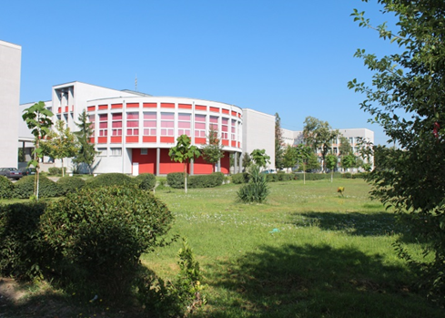
Agricultural University of Plovdiv (AUP), Bulgaria
Favourable conditions to develop Bioeconomy Living Labs and a Regional Knowledge Hub
Demo- and training fields
Vineyards & traditions
Circularity - Processing (winery)
Agri-food business
Research and Innovation
Education
75-years leader in providing higher education at BSc, MSc and PhD level in agri-food sub-sectors of agronomy, plant protection, livestock husbandry, horticulture, agroecology and agricultural economy in Bulgaria.

Slide 3
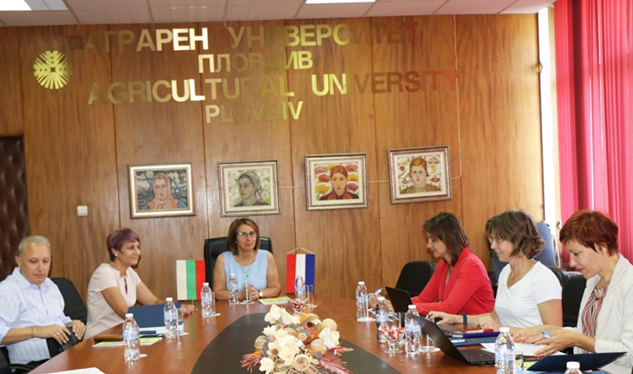

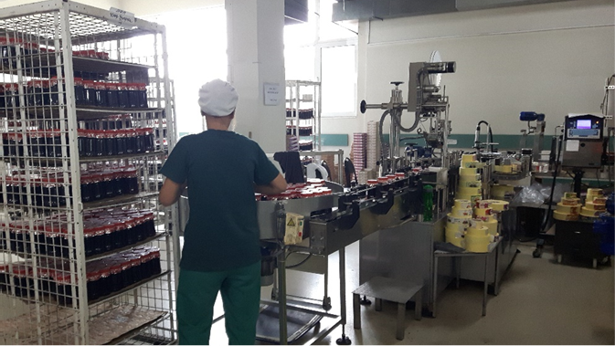
How was the consortium of the project created? What were the necessary preconditions to start the project?
Researchers connected by the Dutch Embassy in Sofia, WUR and AUP
Current state-of-development of R&I in AUP introduced
H2020 Twinning programme opportunity identified
Theme of common (future) interest identified (i.e. Bioeconomy)
Good contacts in network of EU Bioeconomy Universities
Strong involvement of key players in proposal development (by all core partners)
Mutual interest to align current AUP Bioeconomy education programmes with those of the EU advanced universities
Mutual interest to widen collaboration in R&I programmes between AUP Bioeconomy and those of the EU advanced universities
Needs for building capacity on Bioeconomy research at AUP identified
Bioeconomy-advanced sectors in Plovdiv region identified and visited
Needs of regional and national Bioeconomy stakeholders inventorised
Liaison with other projects i.e. CELEBio (BBI-JU) realised
Opportunities for pilot Bioeconomy Living Lab in Plovdiv region identified

Slide 4
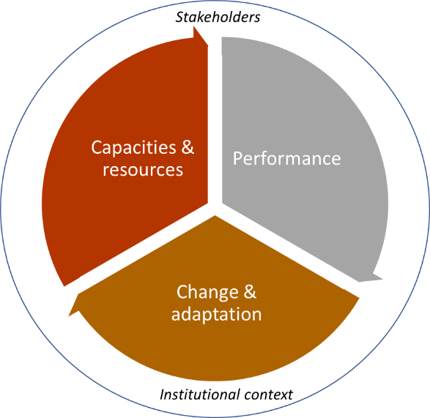
To strengthen the AUP R&I programmes and capacity to develop and implement R&I projects in Bioeconomy value chains at regional, national and international scale
CAPBIO4BG Objectives and Approach
Capacity Building Framework (CBF) for research & innovation
Core task
Scaling up the regional and national Bioeconomy
Establish a critical mass of AUP researchers capable of designing and managing interdisciplinary R&I programmes in Bioeconomy
Increase the AUP researchers’ skills in Bioeconomy R&D project participation and execution
Establish new AUP’s partnerships with regional Bioeconomy stakeholders
Enhance the research profile, recognition and attractiveness of the AUP, peer review publications (h-factor) etc.
Establish inter-disciplinary knowledge data-base and know-how channels and networks on Bioeconomy
H2020 Twinning project: closing innovation gap in Europe
National Programme “European Scientific Networks” of Ministry of Education and Science of Bulgaria

Slide 5
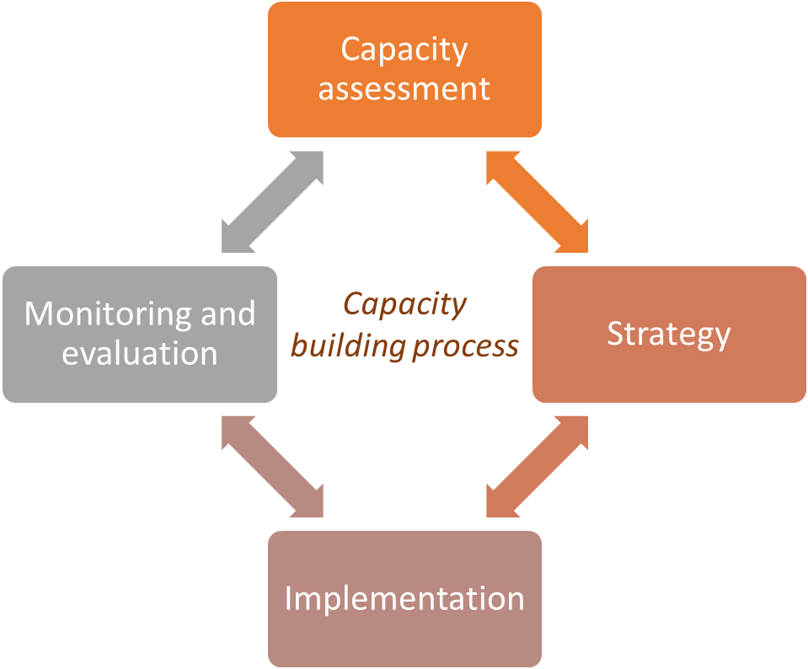
Capacity Building process for Bioeconomy Research & Innovation at AUP
Step 1: Capacity assessment: needs and knowledge gap analysis
Step 4: Monitoring and evaluation of the effectiveness of the capacity building process
Step 2: Development of a strategy and a program for capacity building on Bioeconomy research at the AUP
Step 3: Implementation of Strategy – key roles of the AUP research teams individual, organizational and institutional

Slide 6
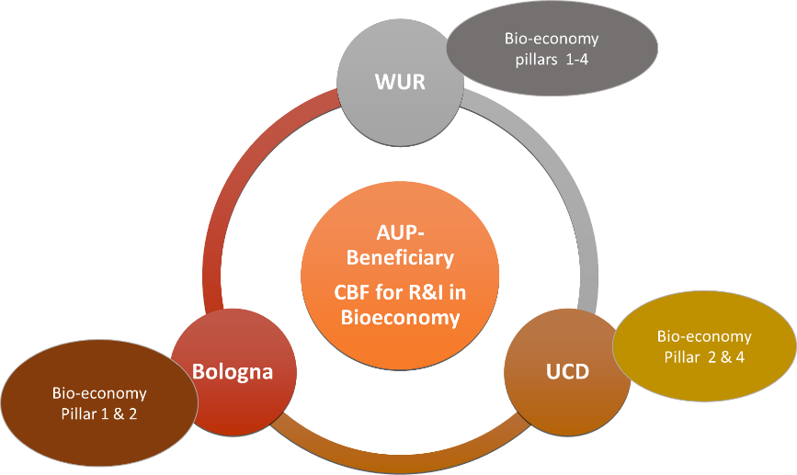
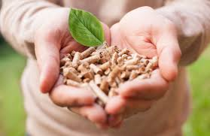
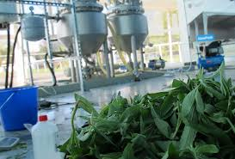


Role of partners WUR, UCD and UNIBO in the knowledge transfer on Bioeconomy in CAPBIO4BG
The Bioeconomy CBF and a new R&I programme at the AUP developed by combining know-how from three advanced EU Universities
The CBF for boosting the R&I potential of AUP based on key pillars:
Biomass Production
Bio-refinery & con-version
Bio-based Circular Economy
Society in Bio-economy
WPs 1-4 Research & Innovation Potential
Notes:
These three pillars of the Bioeconomy concept will address the following key questions, regarding the R&I needs:
What are the multiple value (ecological, social, and economic) that can be supplied by relevant business models and captured by the stakeholders in different sectors and across scales.
What are the technological, organisational, behavioural, market and institutional constraints in implementation of bioeconomy concepts and models
What are the possible pathways for transition to a scalable circular agri-food economy (e.g. reconfiguration, substitution, or transformation)
What are the expected consumer attitudes towards bio-based products.
What new financing policies and socio-economic stimuli can be put at place.

Slide 7
How do you experience the cooperation in the project so far? What are the learnt lessons?
Tuning of national procedures with the EU (e.g. Horizon Europe) procedures
New approaches in pandemic situations
Financial procedures agreed well in advance
Pro-active involvement of all partners is needed
Faster response to the request of the receiving partner (AUP)
More efficient Needs Assessment and Knowledge Gaps studies i.e. for more efficient response to Bioeconomy development
Clear division of know-how transfer for R&I and for Education programmes
More efficient involvement of the Core Focus Group of (future) Bioeconomy researchers
Project is more then exchange of information, but also involves setting up together a change process
Project Management
Collaboration of partners
Know-how exchange/transfer
Involvement of receiving University (i.e. AUP)

Slide 8


What are, in your opinion, crucial factors determining the success or failure of a project like this?
Preparatory phase:
Engagement of partners and key experts/researchers by on-site (country) visits, focus group discussions, etc.
Engagement and involvement of project (target) stakeholders
Adapt approaches/ instruments to local conditions (AUP, Bioeconomy)
Execution phase:
Ensure active involvement of all partners in all project tasks (WPs)
Use efficient learning instruments for know-how transfer
Ensure active participation of selected (core) researchers
Other:
Adjust to and align with the national R&I policies and actions/initiatives
Engage relevant policy-makers in project implementation (national, regional)
Use existing and relevant expertise from previous (or parallel) projects in the topic area
Ensure efficient project communication (incl. at the EU-level)

Slide 9

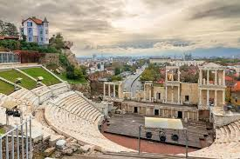
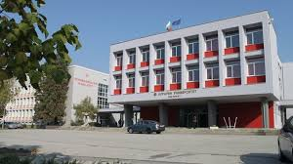
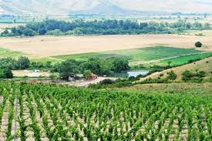


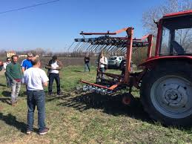
Thank you for your attention…!

